Slide 1
FALL/WINTER PM1/PM2, EOC & READING RETAKES
SCHOOL COORDINATOR
RETURN INSTRUCTIONS
Non-Test Materials

Slide 2
ORGANIZATION OF TEST MATERIALS
In order to better organize these materials for storage, please organize your secure materials by the window of the test administration
FALL – PM1/Retake ADMINISTRATION
High Schools
PM1 (R)
PM3 Retake
BEST Algebra
BEST Geometry
EOC Biology 1
EOC US History
FCLE
FALL – PM1/Retake ADMINISTRATION
Middle Schools
PM1(R/M)
Civics EOC Retake
BEST Algebra
BEST Geometry
Fall – PM1 Administration
Elementary Schools
PM1(R/M)
Notes:
Try and organize items either with clips, rubber bands, or inside a manilla folder

Slide 3
ORGANIZATION OF TEST MATERIALS CON’T…..
WINTER – EOC ADMINISTRATION:
High Schools/Middle Schools
PM3 Retake (HS Only)
BEST Algebra 1 EOC
BEST Geometry EOC
Biology 1 EOC
US History EOC
Civics EOC (MS Only)
All Schools – PM2
High Schools PM2 (R)
Middle Schools PM2 (R/M)
Elementary PM2 (R/M)

Slide 4
ORGANIZATION OF TEST MATERIALS CON’T….
Notes:
Added Test Agreements to the envelope to save an envelope. All of these items are the thigs we must keep for 5 years, so this is the super important stuff!

Slide 5
SEATING CHART
REQUIRED ITEMS:
Date
Name of TA
Room name/number
Subject (Which test)
Student names and their locations
Direction each student is facing
Start and Stop times
Names of proctors (if used)
Test Group code/Session ID
Chromebook # (if not student’s personal)
Notes:
Please be aware that seating charts MUST include this information. Page 25 in the FSA manual and page 27 in the Pearson manual. Please be vigilent in creating these. This is sometimes the most important piece if we have an investigation.

Slide 6
Notes:
Example of a seating chart – you can create a template for your room(s) in power point and then just adjust the particulars

Slide 7
ORGANIZATION OF TEST MATERIALS CON’T….
FALL/WINTER ADMINISTRATION
DISTRICT COORDINATORS’S BOX OR ENVELOPE LABEL:
Notes:
Coordinators box is the bulk of your paperwork – these are the materials that we have to keep for 6 months

Slide 8
RETURNING TEST MATERIALS
MANUALS:
KEEP ALL COPIES OF SCRIPTS AT YOUR SCHOOL FOR THE WINTER AND PM2 ADMINISTRATION
DISTRICT COORDINATOR WILL ADVISE WHEN TO DISPOSE OF – ONCE ALL SCORES HAVE BEEN SUCCESSFULLY REPORTED

Slide 9
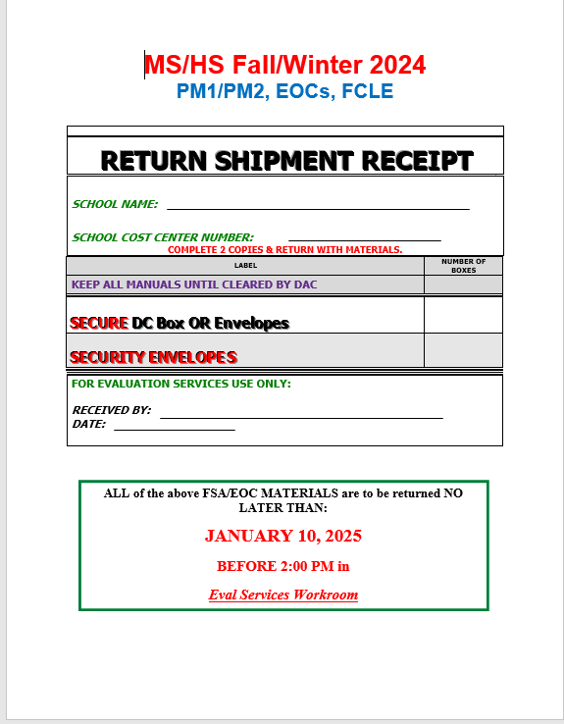
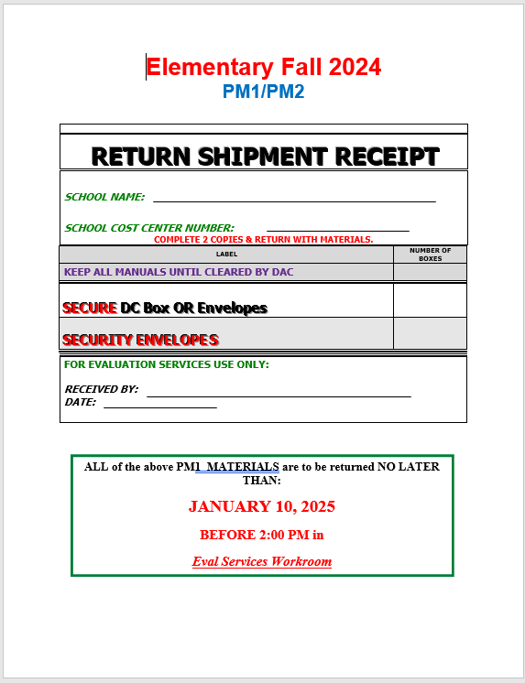
RETURNING TEST MATERIALS CON’T…..
RETURN RECEIPT:
Handed out today
DON’T LOSE ☺
Complete BOTH copies and return with testing materials
NLT: 1/10/2025
Notes:
You are able to bring materails once ALL of your eligible students have tested. Please call to let us know when you will be here and if someone other than you is bringing your materails

Slide 10
QUESTIONS? Heather Rykard, TSA hrykard@ecsdfl.us 850-469-5387/5386 (Main office)

